Slide 1

Introduction to AWS DynamoDB
Amazon Web services

Slide 2
Amazon DynamoDB
Fully managed, highly available with replication across multiple AZs
NoSQL database - not a relational database
Scales to massive workloads, distributed database
Millions of requests per second, trillions of rows, 100s of TB of storage
Fast and consistent in performance (low latency on retrieval)
Integrated with IAM for security, authorization and administration
Enables event-driven programming with DynamoDB Streams
Low cost and auto-scaling capabilities

Slide 3
DynamoDB Basics
DynamoDB is made of Tables
Each table has a Primary Key (which must be decided at creation time)
Each table can have an infinite number of items (= rows)
Each item has attributes (can be added over time – can be null)
The maximum size of an item is 400KB
Data types supported are:
Scalar Types – String, Number, Binary, Boolean, Null
Document Types – List, Map
Set Types – String Set, Number Set, Binary Set

Slide 4
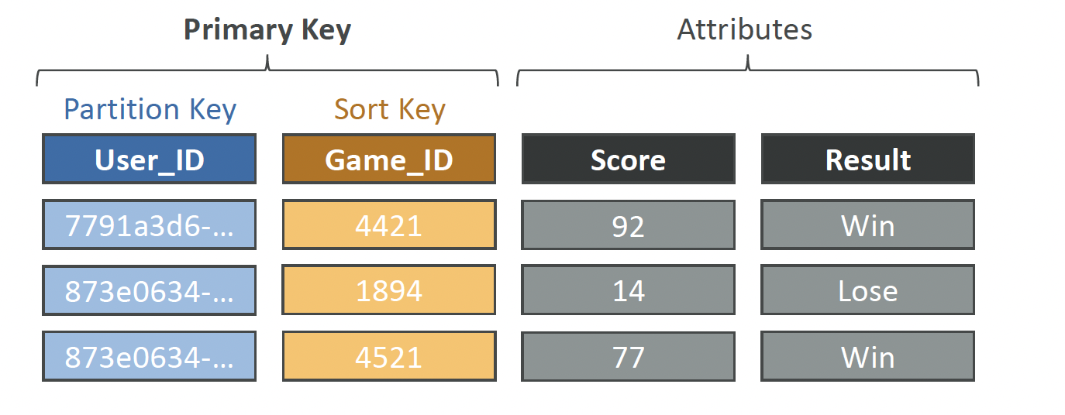
DynamoDB Table Example

Slide 5
DynamoDB – Read/Write Capacity Modes
Provisioned Mode (default)
You specify the number of reads/writes per second
You need to plan capacity beforehand
Pay for provisioned Read Capacity Units (RCU) & Write Capacity Units (WCU)
Possibility to add auto-scaling mode for RCU & WCU
On-Demand Mode
Read/writes automatically scale up/down with your workloads
No capacity planning needed
Pay for what you use, more expensive

Slide 6
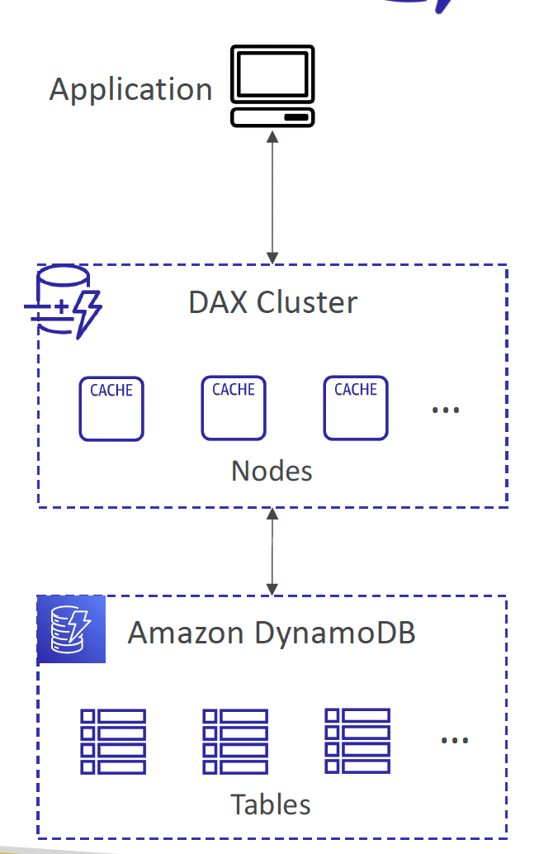
DynamoDB Accelerator (DAX)
Fully-managed, highly available, seamless in memory cache for DynamoDB
Help solve read congestion by caching
Microseconds latency for cached data
Doesn’t require application logic modification
(compatible with existing DynamoDB APIs)
5 minutes TTL for cache (default)

Slide 7
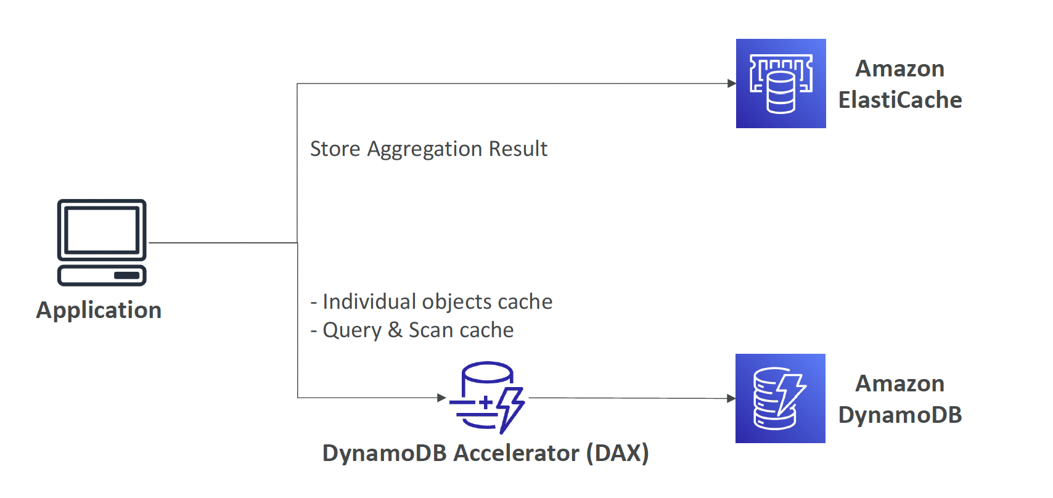
DynamoDB Accelerator (DAX) vs. ElastiCache

Slide 8
DynamoDB Streams
Ordered stream of item-level modifications (create/update/delete) in a table
Stream records can be:
Sent to Kinesis Data Streams
Read by AWS Lambda
Read by Kinesis Client Library applications
Data Retention for up to 24 hours
Use cases:
react to changes in real-time (welcome email to users)
Analytics
Insert into derivative tables
Insert into ElasticSearch
Implement cross-region replication

Slide 9
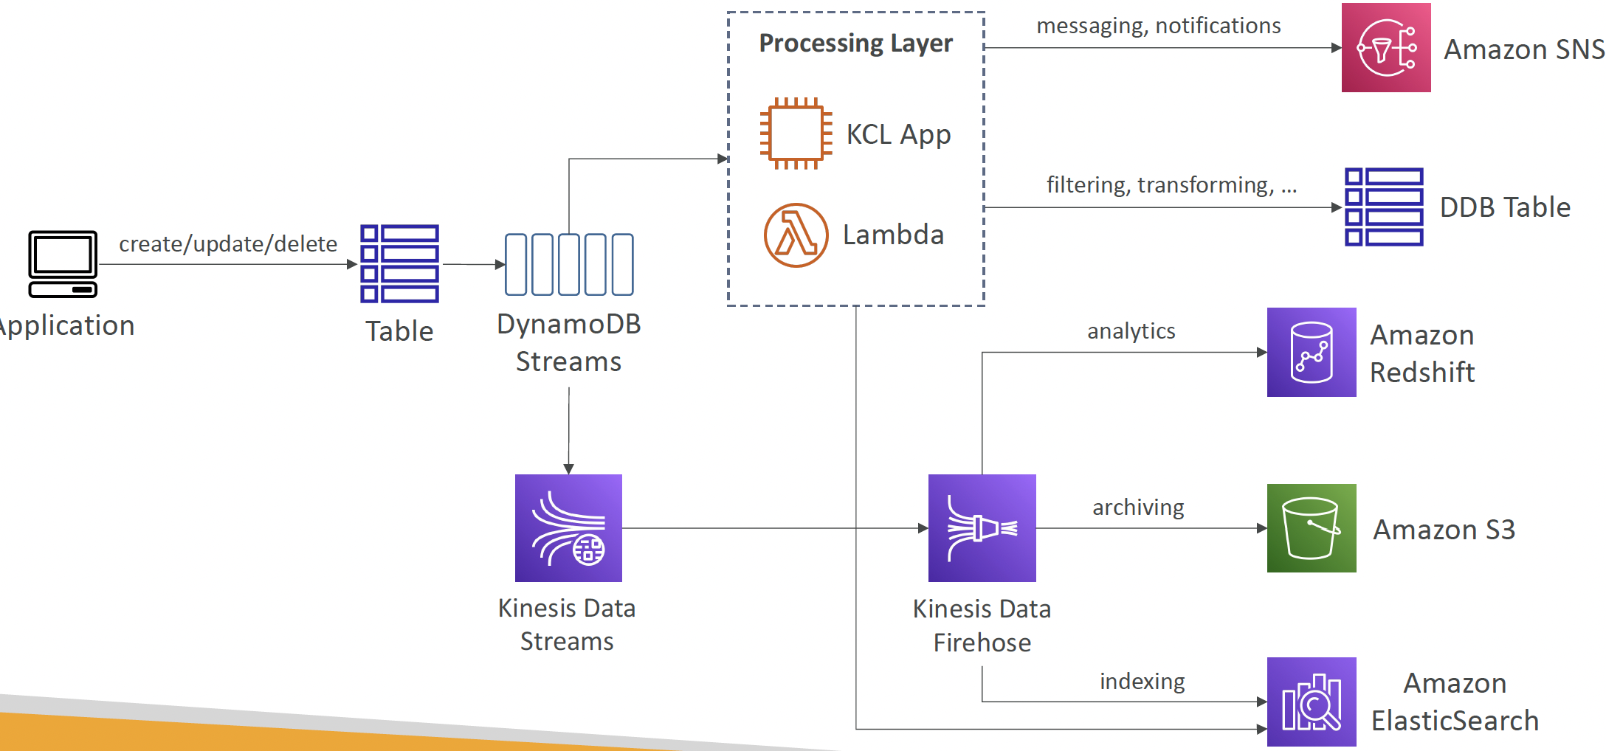
DynamoDB Streams

Slide 10
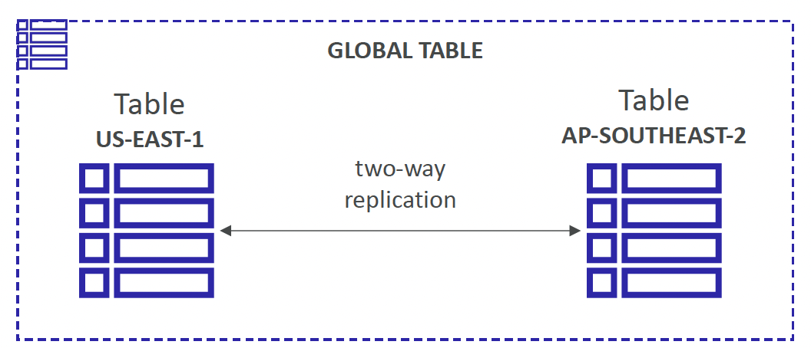
DynamoDB Global Tables
Make a DynamoDB table accessible with low latency in multiple-regions
Active-Active replication
Applications can READ and WRITE to the table in any region
Must enable DynamoDB Streams as a pre-requisite

Slide 11
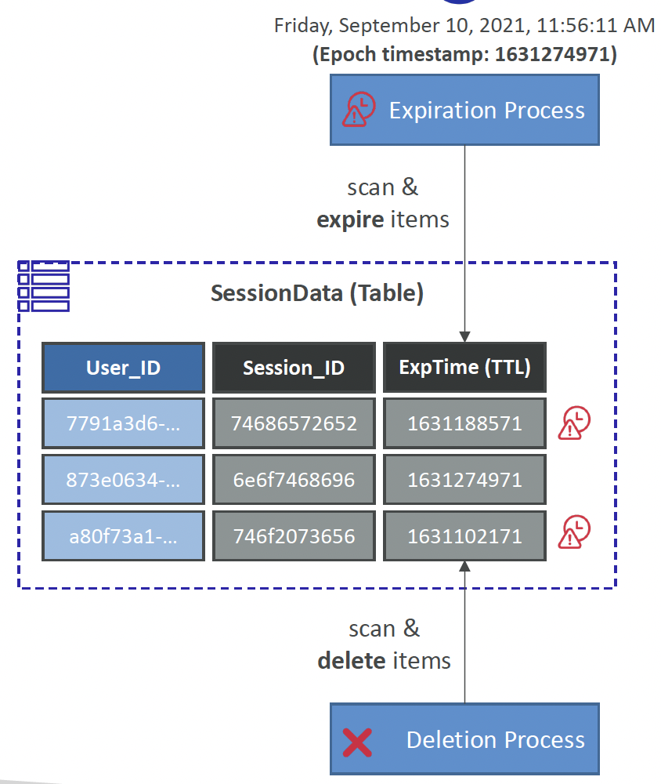
DynamoDB TTL

